Slide 1
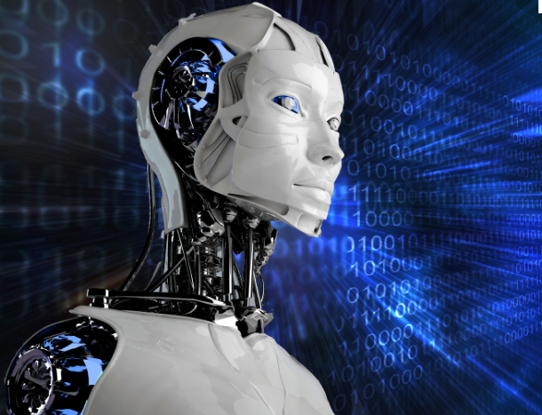
ROBOTICS M.DRUMARE

Slide 2
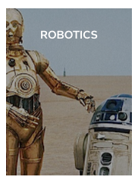
ON FLIPBOARD
http://flip.it/Mlqzun

Slide 3
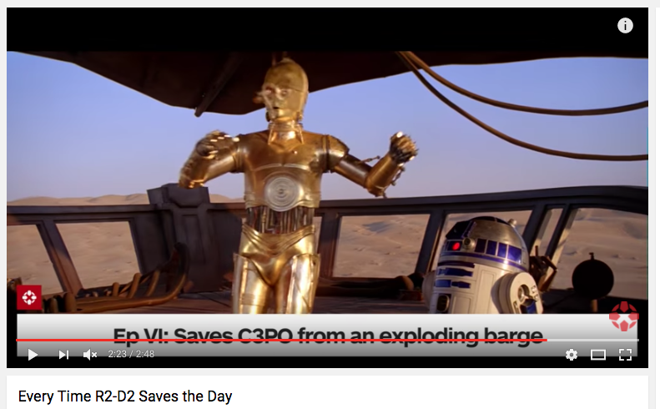
R2D2

Slide 4

WALL-E

Slide 5
WHAT ?

Slide 6
ROBOT DEFINITION
Even Joseph Engelberger, often credited as the “Father of Robotics,” was said to have once remarked, "I can't define a robot, but I know one when I see one.”
The Robot Institute of America (1979) defines a robot as
« A reprogrammable, multifunctional manipulator designed to move material, parts, tools, or specialized devices through various programmed motions for the performance of a variety of tasks. »

Slide 7
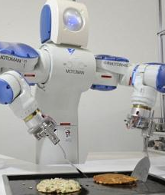
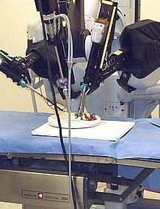
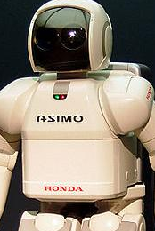
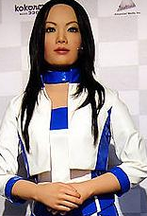
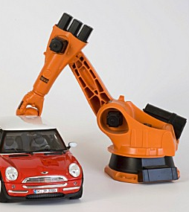
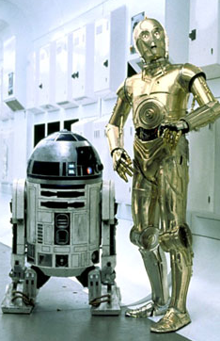
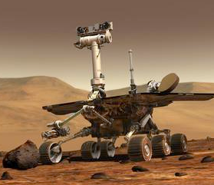
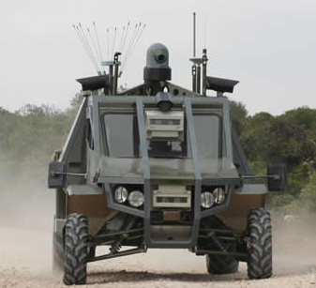
DIFFERENT TYPE OF ROBOTS
Domestic and Cooking Robots
Medical Robots and Robotics
Humanoid Robots
Androids
Industrial Robots
Space Robots
Military Robots
Star Robots

Slide 8
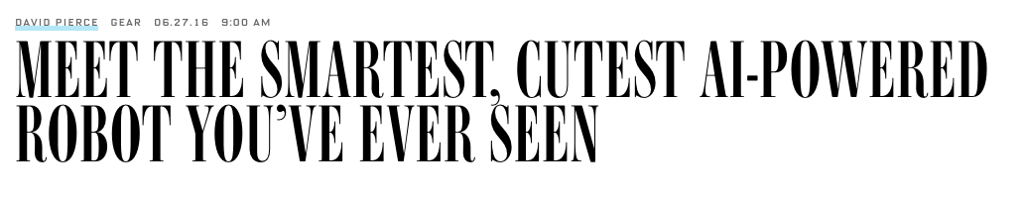
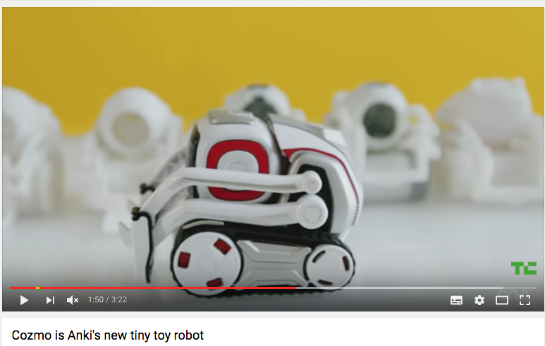
SMARTER ROBOTS
Robots cannot easily adapt to a new task, and cannot cope with an unfamiliar or uncertain situation.
Things are changing, however, thanks to new techniques and algorithms that are enabling robots to learn much more quickly and effectively.
Cozmo : a unique combination of computer-vision science, advanced robotics, deep character development, and a set of machine-learning algorithms that Anki calls the “emotional engine,”
Cozmo is meant to be something very much like a real-life version of Wall-E or R2-D2. It’s not human, but it feels real.

Slide 9
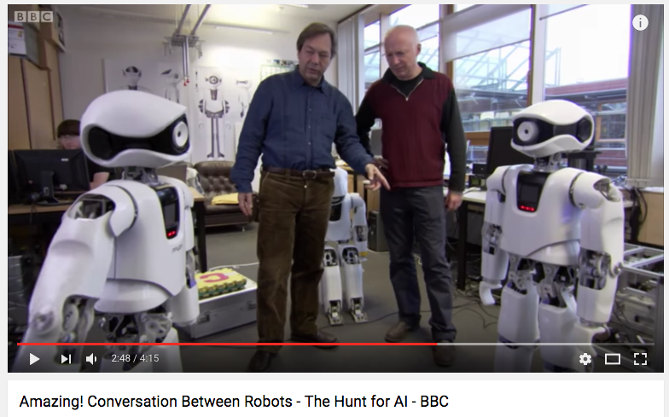
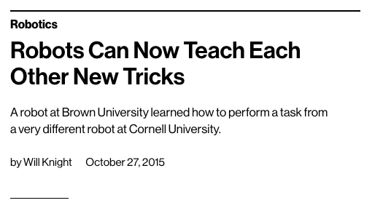
KNOWLEDGE SHARING
Another trend to look out for this year is robots sharing the knowledge they have acquired with other robots.
This could accelerate the learning process, instantly allowing a robot to benefit from the efforts of others .

Slide 10
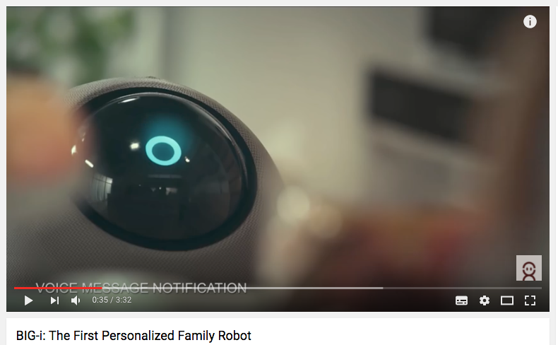
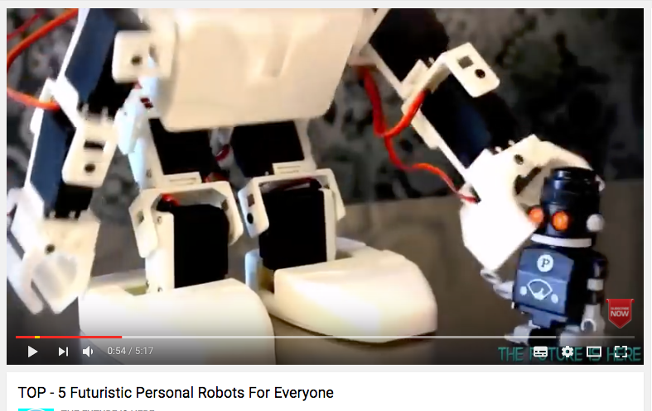
PERSONAL ROBOTS
With hardware becoming cheaper and software becoming more capable.
Time is right for robotic home companions and helpers.
BIG-i is a natural-interaction robot with mobility, 3D vision , voice programming, and active perception. It can manage smart appliances to suit your needs.

Slide 11
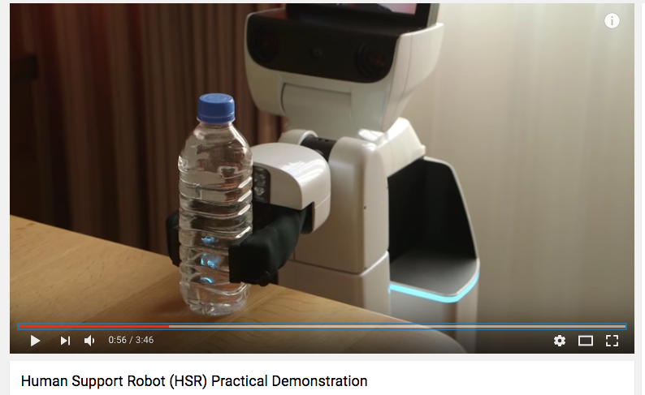
HUMAN SUPPORT ROBOT
Toyota’s answer to the ever-increasing demand for long-term elderly care in societies like Japan.
The HSR can pick objects up off the floor, retrieve objects from shelves, and perform a variety of other tasks.

Slide 12
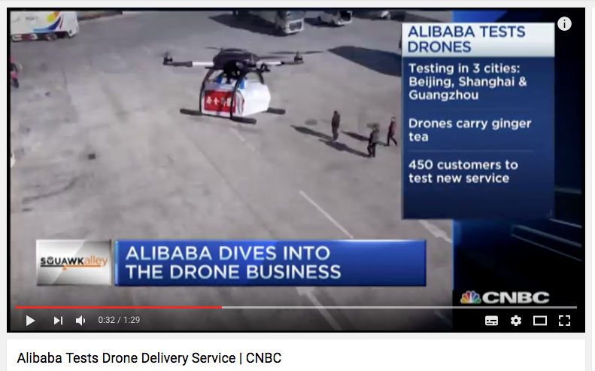
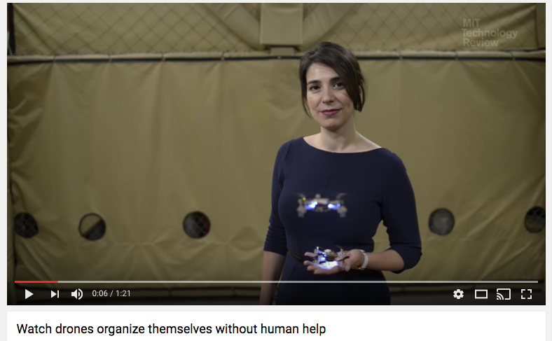
DRONING ON
A drone is a flying robots.
2016 was the year that autonomous drones finally take off.
Chinese e-commerce giant Alibaba has partnered with a local courier service to experiment with drone deliveries
Future innovation: Improve drones coordination. Use artificial intelligence and navigational systems to allow drones to fly low and fast, avoiding obstacles in structure-dense environments.

Slide 13
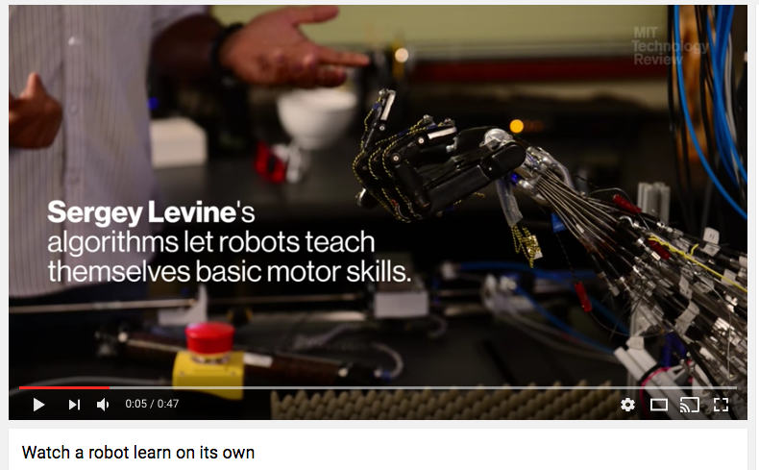
ROBOTS MEET AI : ROBOTS LEARN ON ITS OWN
Serguey Levine’s breakthrough was to use the same kind of algorithm that has gotten so good at classifying images.
After he gives the robot some easy-to-solve versions of the task at hand—instructing it to screw on the cap, for example—the robot then retrospectively studies its own successes.
It observes how the data from its vision system maps to the motor signals of the robotic hand doing the task correctly.
The robot supervises its own learning. “It’s reverse--engineering its own behavior,”

Slide 14
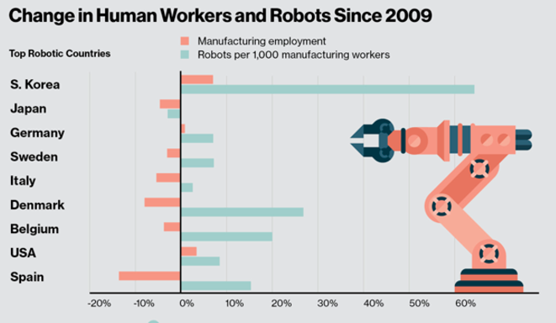
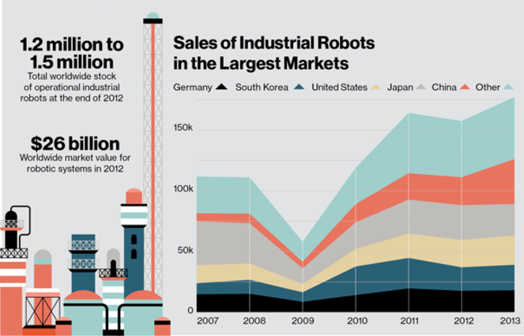
ROBOTS RISING
Manufaturers bought more industrial robots in 2013 than ever before.
Human force has declined or grown slowly.

Slide 15
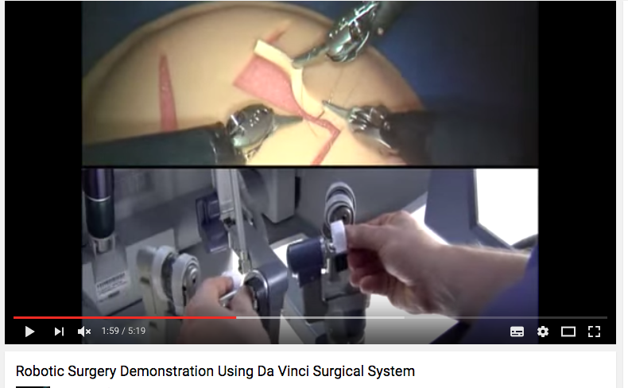
ROBOTS RISING
Asia/Pacific: robotics spending $46.8 billion in 2015 vs $14.6 billion for EMEA.
Global robotics spendings in 2015 was $71 billion, and is set to grow at a compound annual growth rate of 17%.
Spendings on robotics and related services will hit $135.4 billion in 2019.
The two fastest growing industries for robotics are healthcare and process manufacturing (sodas, drugs, etc). The healthcare sector is expected to see a bump in robotics : spendings expected to double by 2019.

Slide 16
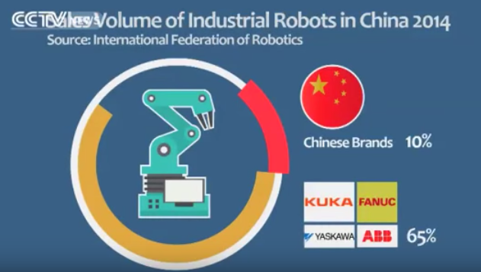
CHINA ROBOTS REVOLUTION
In 2013, China became the world’s largest importer of robots.
Made in China 2025, which aims to make China an innovative and green “world manufacturing power” by that year.
The effort involves adding connectivity and intelligence to manufacturing equipment and factories, to improve overall flexibility and efficiency.

Slide 17
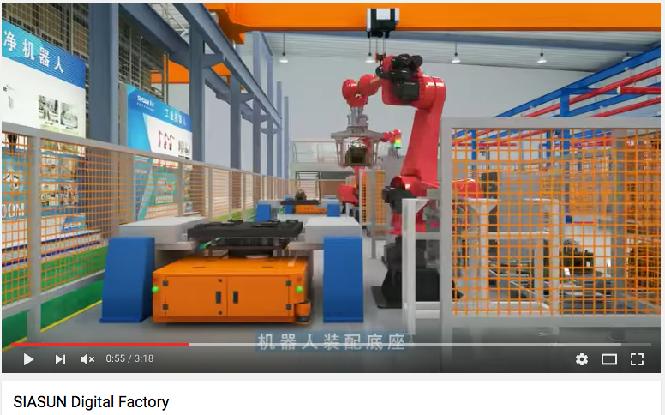
CHINA ROBOTS REVOLUTION
China may soon become not only an important market for more advanced robotic technology, but a producer of more advanced robot systems itself.
Siasun, an industrial robot manufacturer based in Shanghai, is developing a range of robots designed to help factories automate more of their work.

Slide 18
HOW ?

Slide 19
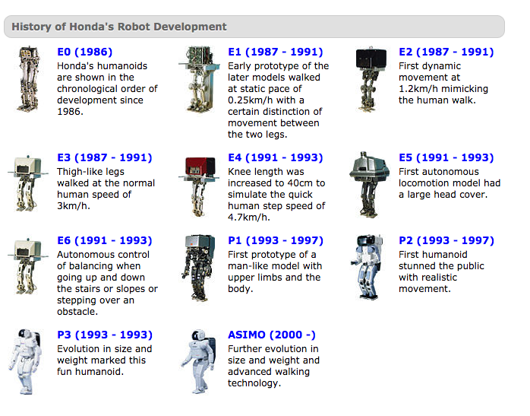
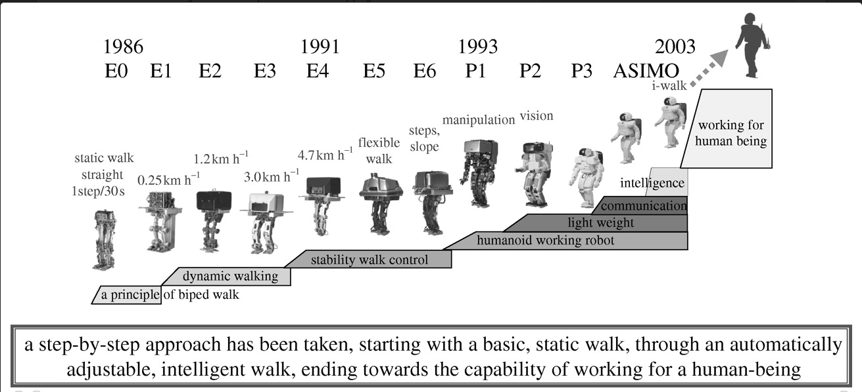
LONG TERM INVESTMENT : HONDA
Honda has been doing research on robotics since 1986 with a focus upon bipedal walking technology.

Slide 20
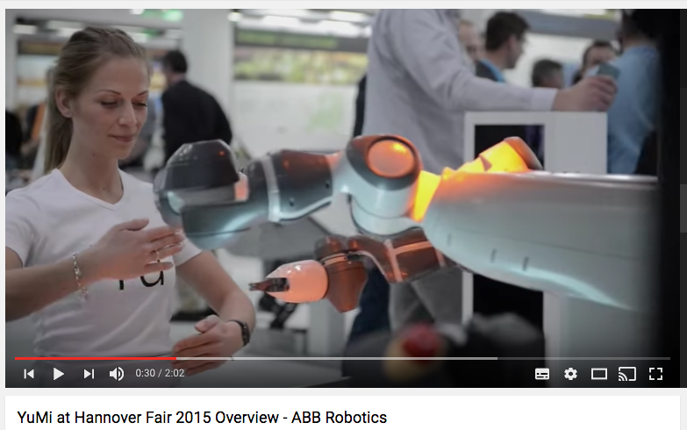
INNOVATE : PIONEER ABB
ABB (ASEA Brown Boveri) is a Swedish-Swiss multinational corporation operating mainly in robotics, power and automation.
ABB has operations in around 100 countries, with approximately 135,000 employees in December 2015 and reported global revenue of $35.5 billion for 2015.
In 2015, introduction of YuMi, the world’s first truly collaborative dual-arm industrial robot, ABB Robotics is pushing the boundaries of robotic automation with precise motion control.

Slide 21
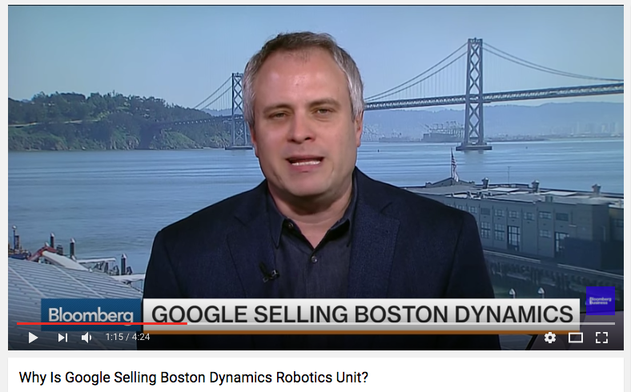
ACQUIRE: GOOGLE AND BOSTON DYNAMICS
In 2013 Google bought seven robotics companies. One of them was Boston Dynamics. In 2016 Google wants to sell out Boston Dynamics. Why?
Google realized that it will take at least a decade to turn the operation into a profitable revenue stream.
When Google started to shepherd ‘Boston Dynamics' roboticists towards creating a machine that helped out around the home and asked them to switch to electronics instead of hydraulics to make the robots quieter, many of the employees of Boston Dynamics were unhappy.
They started to resist pressure from Google to build a consumer product, and instead pursued their own research.

Slide 22
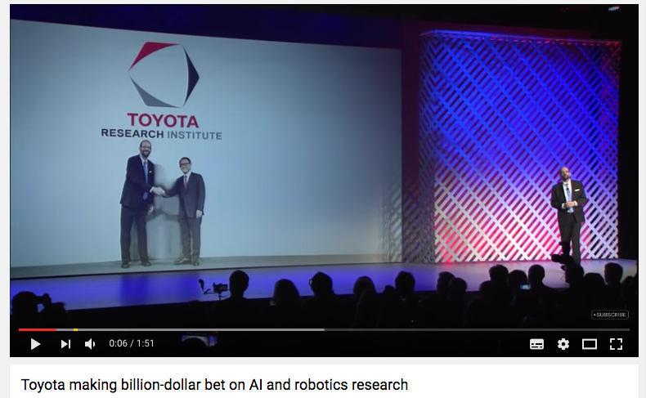
BUILD STRONG EXPERTISE : TOYOTA
$1 billion investment into robotics and self-driving cars aiming.
Toyota Research Institute has three facilities : Ann Arbor partnering with University of Michigan, Cambridge with MIT, Silicon Valley partnering with Stanford.
TRI focuses on vehicle safety and autonomy features and also mobility beyond cars—looking at robotics applications, especially for an aging population in Japan, and using the modern cloud computing infrastructure to accelerate scientific discovery.
Mix of artificial intelligence experts : academics, researchers, experienced technology veterans from Silicon Valley, longtime career Toyota engineers.

Slide 23
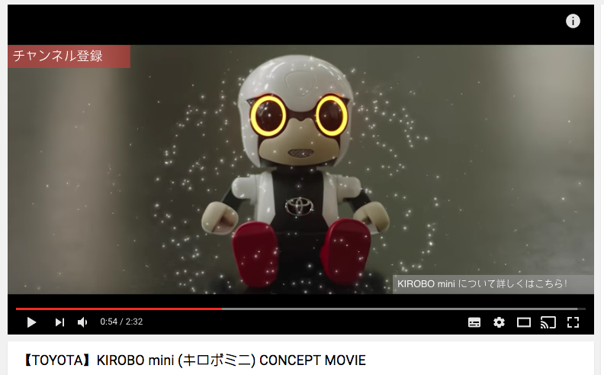
IDENTIFY SYNERGIES : TOYOTA KIROBO MINI
In 2017, Toyota Motor Corp want to sell a personal robot in Japan called Kirobo Mini that is designed to provide companionship to people.
The Robots will go on sell in Toyota dealership for $400.
Kirobo can maintain eye contact and gesticulate as it chats in “casual conversation” with a driver.
The robot has a built-in camera that allows it to track people’s faces, as well as their emotions.
Kirobo is intended to keep drivers engaged on long car journeys

Slide 24
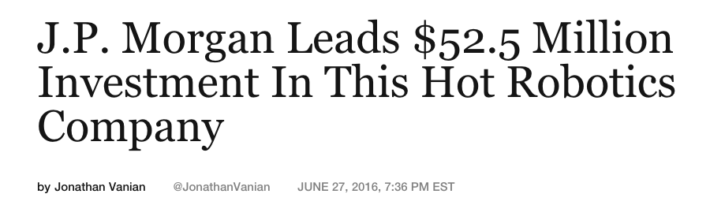
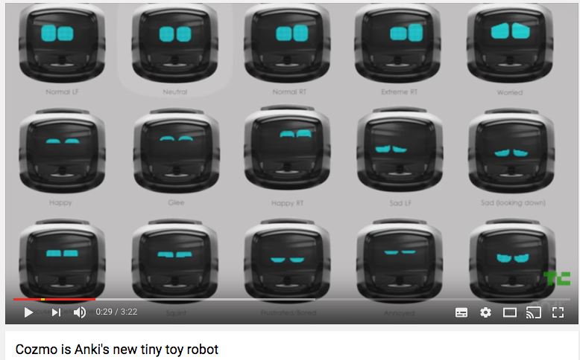
MAKE IT SMART AND FUN : ANKI
Initial Idea : Bring cutting edge robotics into peoples' lives.
Ability to convince Investors : $52.5 million from J.P Morgan in 2016.
‘Use existing technology different’ : In 2013, Apple CEO Tim Cook invited the startup on stage during Apple’s 2013 developer conference.
Anki developpers were using Apple APi in a very different way than other developers were doing.

Slide 25
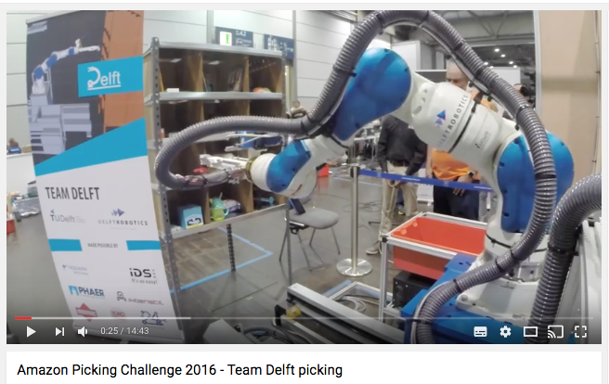
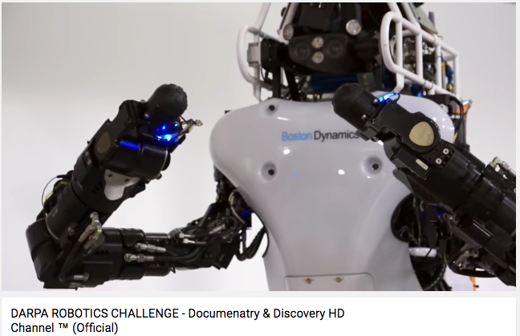
ROBOTICS CHALLENGE : AMAZON, DARPA
Amazon Picking Challenge : teams competed for a $25,000 prize by designing a robot to identify and grasp items from one of Amazon’s storage shelves as quickly as possible.
DARPA Robotics Challenge, the event was designed to inspire the creation of humanoid robots capable of taking over in highly dangerous disaster scenarios.
DARPA’s goal with the DRC was not to develop a robotic platform that could be immediately deployed into disaster areas and be helpful. What DARPA is all about high reward, long-term technological pushes.

Slide 26
IMPACTS ?

Slide 27
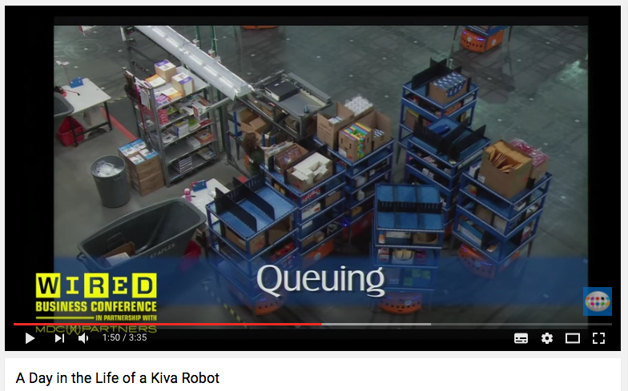
IMPACT ON SUPPLY CHAIN
Amazon bought Kiva systems for an estimated $775 million.
They implemented the Kiva system across several of their warehouses.
The system consists of robots moving stacks or individual boxes throughout the warehouses without the need for human input.
This has improved their efficiency considerably as well as allowing them to become more profitable whilst keeping their workforce to a minimum level.

Slide 28
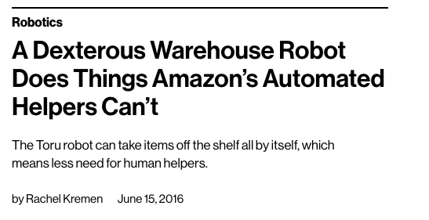
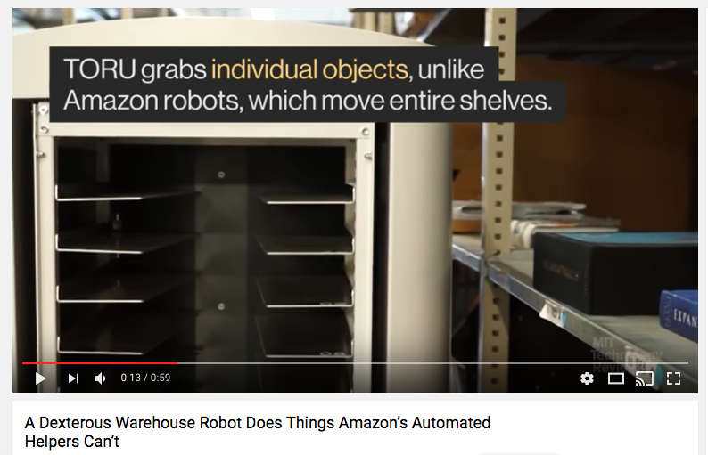
IMPACT ON SUPPLY CHAIN
For a four-item order, for instance, the Amazon robot might have to bring four shelves to the shipping station and then take those shelves back, for a total of eight trips.
Toru can go to each of the four shelves one after the other and deliver them all to the shipping station in one trip. And there are no shelves to return.
Toru Cube is used for gripping single rectangular objects. Toru Box is best for gripping standardized containers, boxes, or trays. Toru Flex can be used to pick up irregular shapes, such as an individual teddy bear from a box of bears.

Slide 29
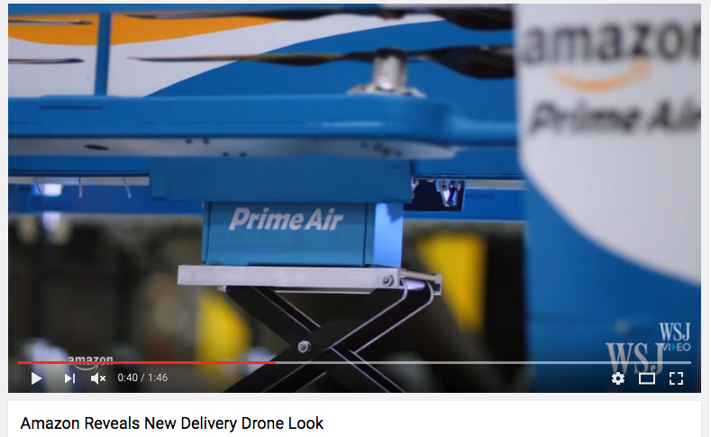
IMPACT ON SUPPLY CHAIN
Use of drones or automated trucks may well revolutionize the way that goods are transported once they leave the warehouse.
Amazon Prime Air is a future delivery system from Amazon designed to safely get packages to customers in 30 minutes or less using small unmanned aerial vehicles, also called drones.
Prime Air has great potential to enhance the services increasing the overall safety and efficiency of the transportation system.

Slide 30
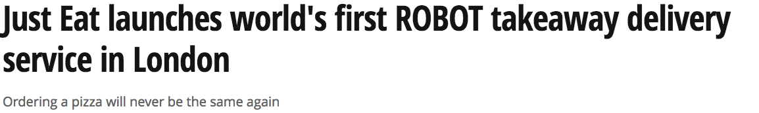
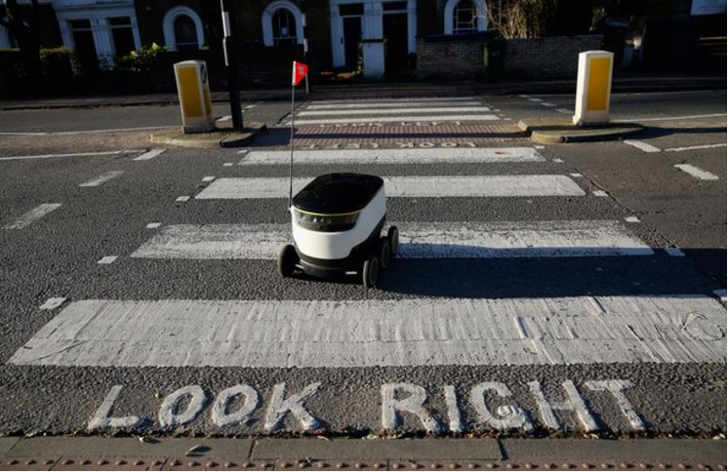
IMPACT ON SERVICES
The first recipient of a robot food delivery was local Greenwich resident Simone.
Rather than a being delivered by a courier on a motorbike, the food turned up on her doorstep inside one of the six-wheeled pavement droids.
"I couldn't believe my eyes when I opened the door to find a robot waiting to greet me – it was like something out of a movie," said Simone.
"It is really incredible to think that this kind of technology and service is now available. It was very efficient and actually texted me when it pulled up. The only thing I wasn't sure of is whether or not to tip! »
The robots are designed and manufactured by Starship Technologies, established in 2014 by the co-founders of Skype.

Slide 31
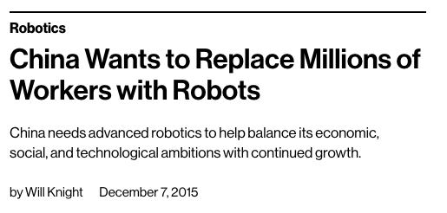
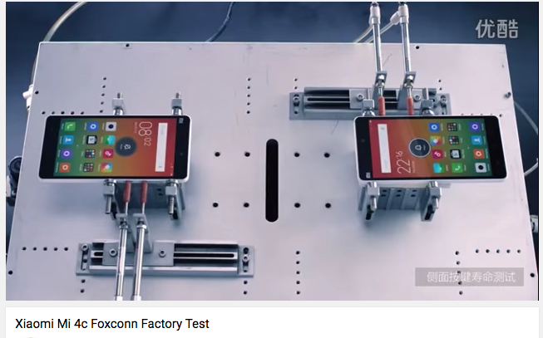
IMPACT ON JOBS
Foxconn Technology Group, is the world's largest electronics contractor manufacturer, making products such as the iPhone and iPad.
It employs more than 1 million workers, mostly in its factories in China, but has been moving toward automation – replacing workers with robots.
Smaller Chinese factories can’t afford to invest in robotics, and factory wages are still relatively low.
Robots and automation are taking away entire categories of jobs, but it has never been a better time for workers to get higher-skilled.

Slide 32
IMPACT ON ECONOMY
In March 2015, a paper by Georg Graetz of Uppsala University and Guy Michaels of the London School of Economics titled "Robots at Work" studied the effects of robots in the economy.
They looked at the United States and 16 other countries, and analyzed a variety of data for a 15-year period ending in 2007.
The increasing use of industrial robots over the time period raised the annual growth of GDP by 0.37%
Robots increased both wages and total factor productivity.
Robots had no significant effect on total hours worked.
Robots reduced the hours of both low skilled and middle skilled workers

Slide 33
